Slide 1
Multiple Sequence Alignment of the mexB gene in Pseudomonas aeruginosa
Ally Watkins

Slide 2
Introduction
Pseudomonas aeruginosa
Gram negative
Non-spore forming
Rod
Versatile
Multidrug resistance -> Challenging pathogen to treat
Investigating multidrug resistance gene to determine
Functional importance of resulting protein
Evolutionary relationships between species
Notes:
Wilson MG, Pandey S. Pseudomonas aeruginosa. [Updated 2023 Aug 8]. In: StatPearls [Internet]. Treasure Island (FL): StatPearls Publishing; 2024 Jan-. Available from: https://www.ncbi.nlm.nih.gov/books/NBK557831/

Slide 3
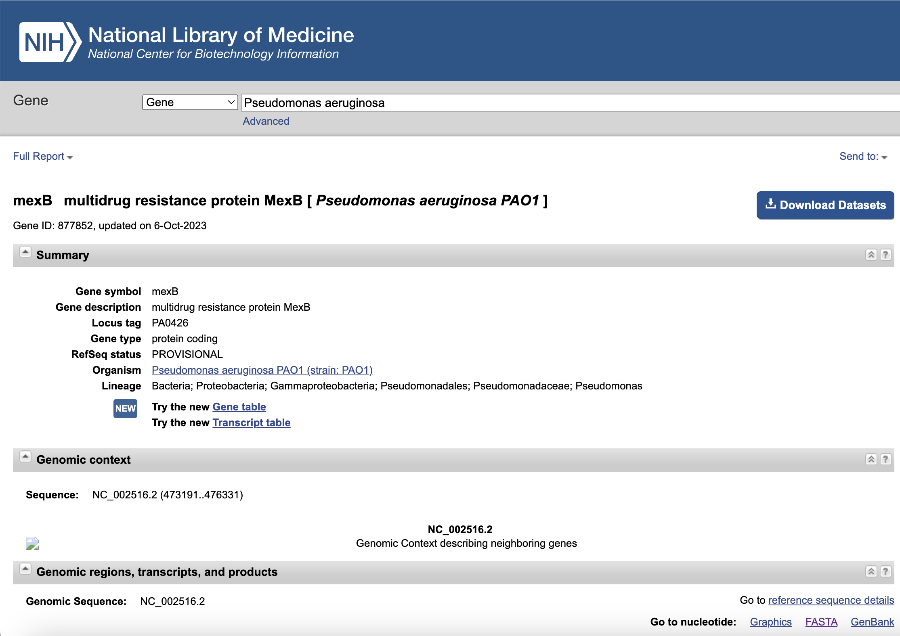
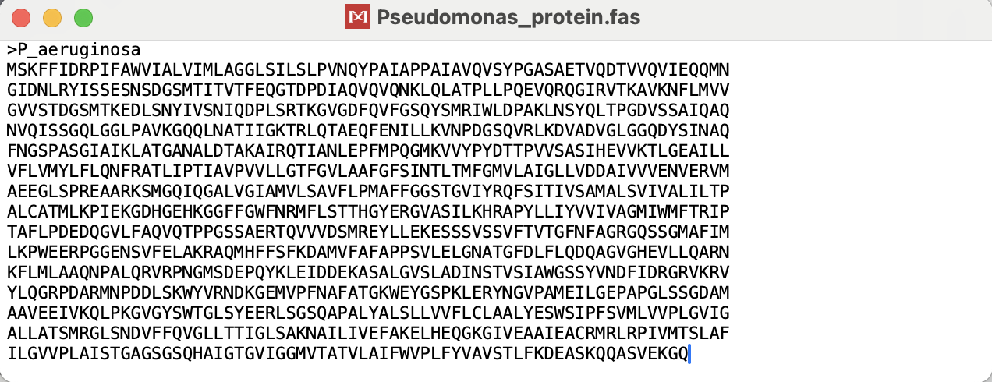
Finding Data
Gene and amino acid sequence copied and pasted into separate .fas files

Slide 4
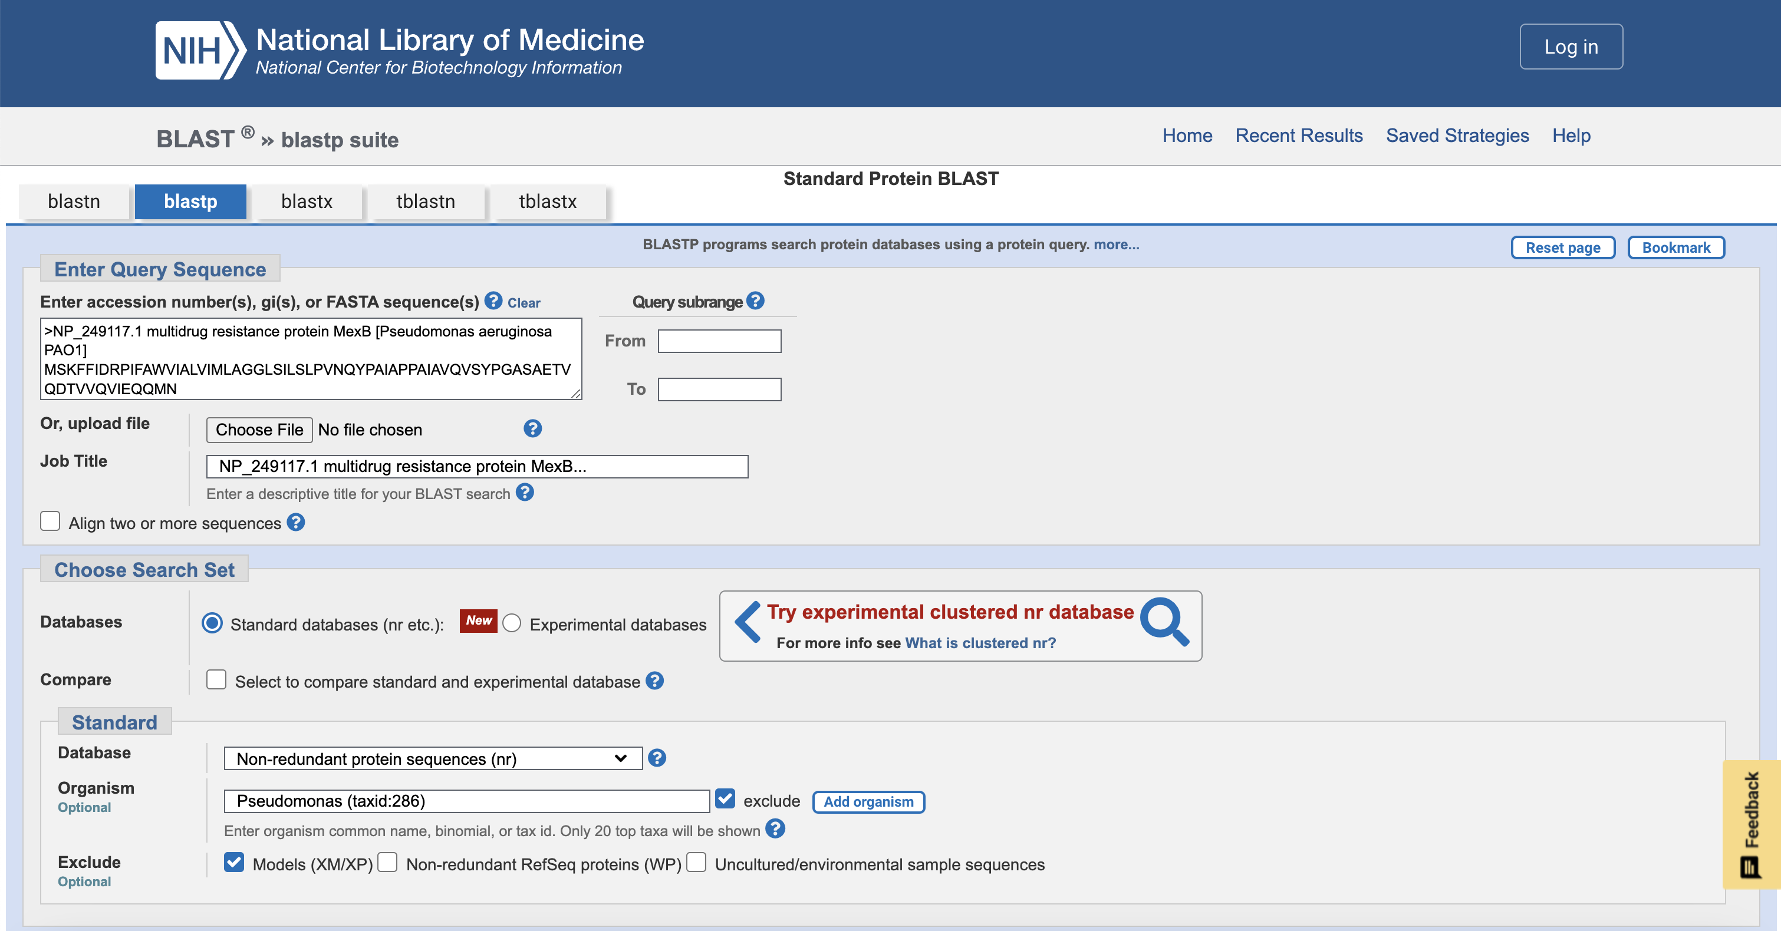
Finding Close Relatives
BLASTn and BLASTp run excluding pseudomonas

Slide 5
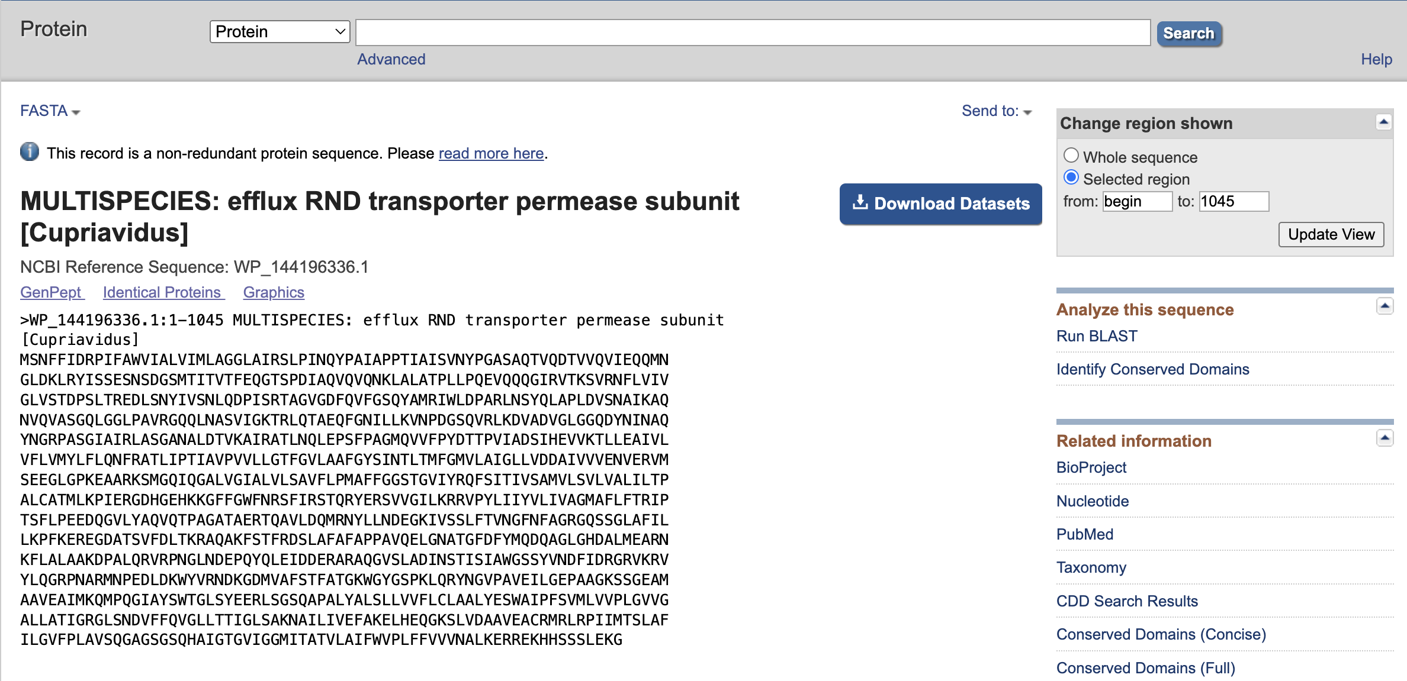
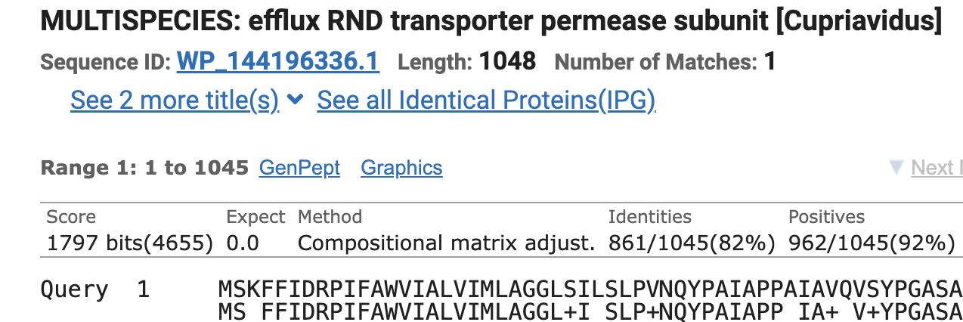
Retrieving Sequences
Top species from unique genera were selected
FASTA with nucleotide or amino acid species was restricted to range

Slide 6
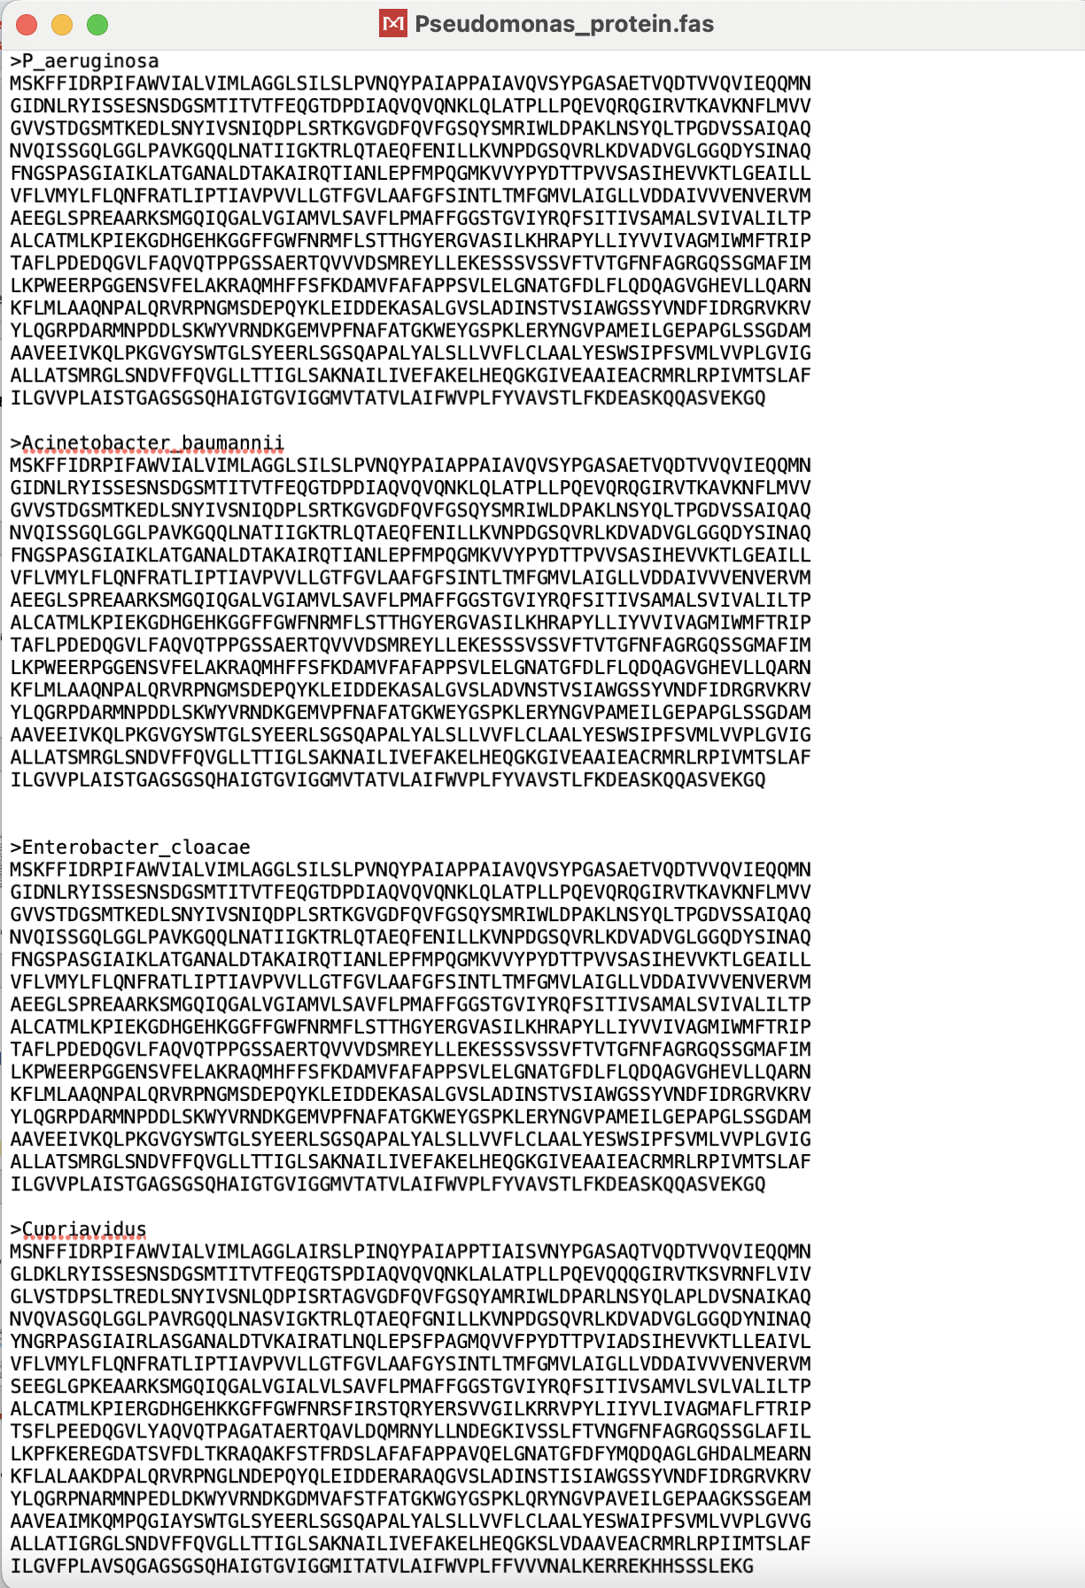
Preparing .fas files
The nucleotide and protein .fas files were updated to include the top 3 species from each respective BLAST

Slide 7
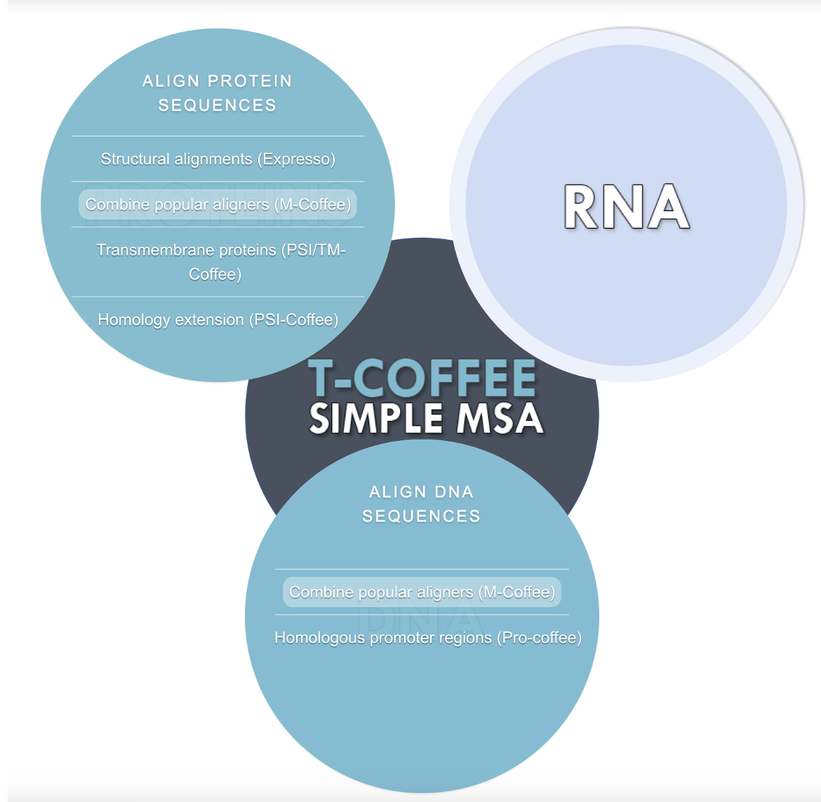
Creating the Alignments
Used T-Coffee Simple Multiple Sequence Aligner
Input .fas files to align P. aeruginosa with closely related species
Performed for DNA and Protein
M-Coffee: Combines results between other aligners showing agreement

Slide 8
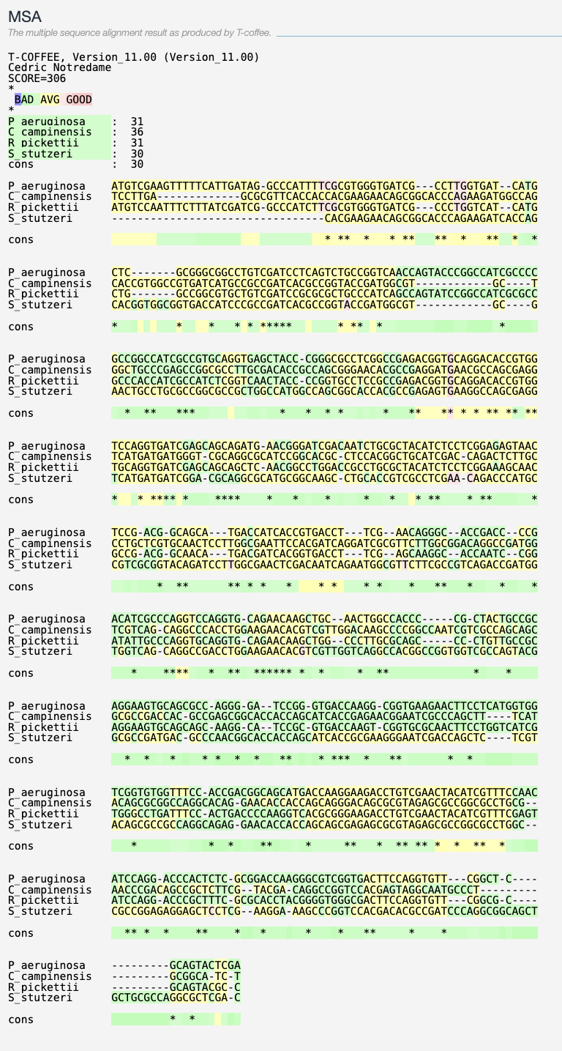
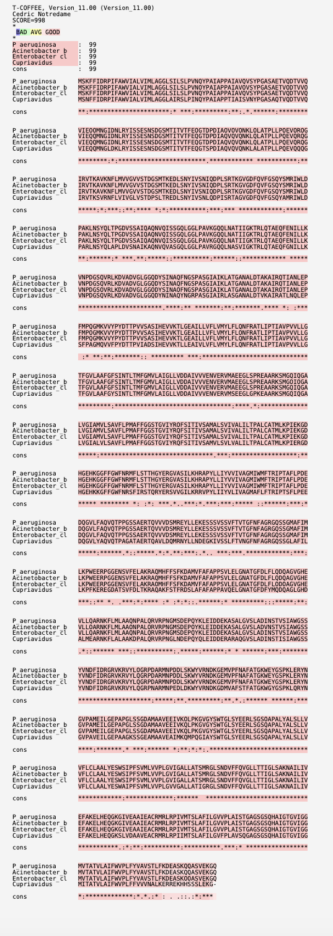
T-Coffee
Color coding indicates level of agreement between aligners
Score tells us consistency across each aligner from 1-100
<50 = unreliable
Normal for DNA to appear more distantly related

Slide 9
T-Coffee Alignments
Low level of agreement for DNA alignment
All results scored < 50
Different DNA sequences may encode same protein

Slide 10
T-Coffee Alignments
High level of agreement for protein alignment
All results score = 99
Protein is conserved across species

Slide 11
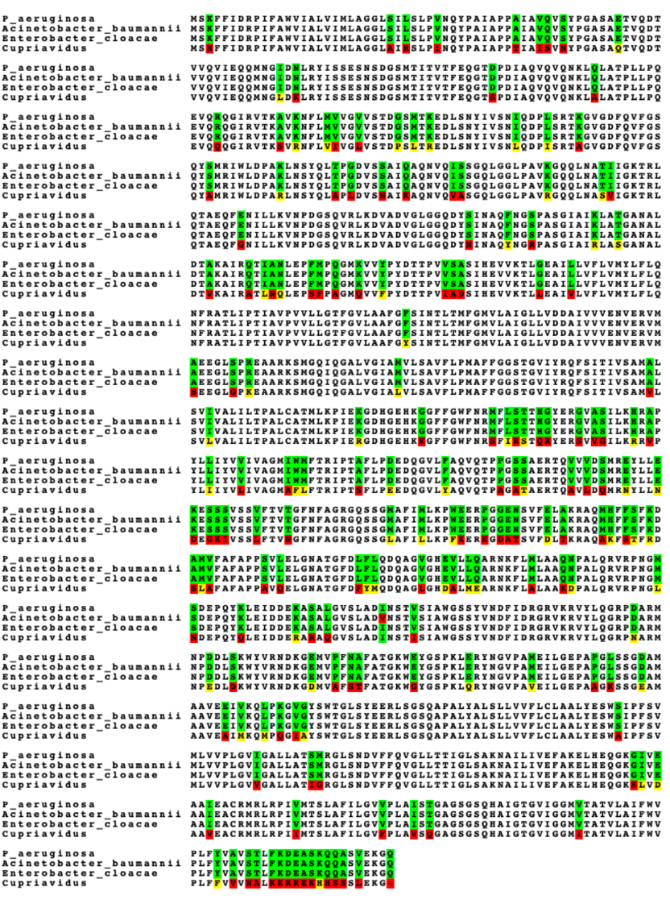
Visualizing Protein Results
Output files downloaded from T-Coffee
Result.fasta_aln file opened in boxshade to generate high quality output of MSA
Red = Different from consensus
Green = Identical to consensus
Yellow = Similar to the consensus

Slide 12
Creating .mas
MEGA Alignment Sequence file = .mas file
Alignment created on MEGA using protein .fas file
Results downloaded as .mas file
This file is used on MEGA to create pairwise distance and phylogenetic trees

Slide 13
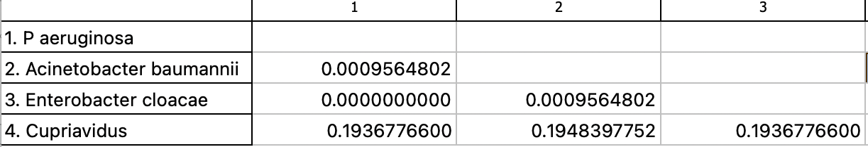
Pairwise Distances
Estimation of evolutionary divergence between sequences
Number corresponds with differences in amino acid sequences
Pseudomonas aeruginosa and Enterobacter cloacae are most closely related
Acinetobacter baumannii and Cupriavidus are least closely related
Notes:
Table. Estimates of Evolutionary Divergence between Sequences
The number of amino acid substitutions per site from between sequences are shown. Analyses were conducted using the Poisson correction model [1]. This analysis involved 4 amino acid sequences. All ambiguous positions were removed for each sequence pair (pairwise deletion option). There were a total of 1046 positions in the final dataset. Evolutionary analyses were conducted in MEGA11 [2][3]
1. Zuckerkandl E. and Pauling L. (1965). Evolutionary divergence and convergence in proteins. Edited in Evolving Genes and Proteins by V. Bryson and H.J. Vogel, pp. 97-166. Academic Press, New York.
2. Tamura K., Stecher G., and Kumar S. (2021). MEGA 11: Molecular Evolutionary Genetics Analysis Version 11. Molecular Biology and Evolution https://doi.org/10.1093/molbev/msab120.
3. Stecher G., Tamura K., and Kumar S. (2020). Molecular Evolutionary Genetics Analysis (MEGA) for macOS. Molecular Biology and Evolution 37:1237-1239.

Slide 14
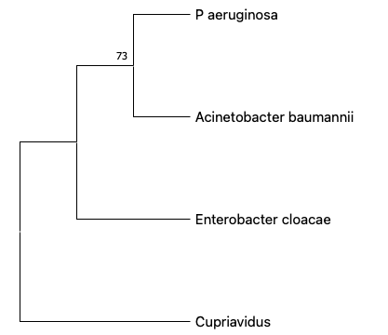
Minimum Evolution Tree: Bootstrap 500
Tree created that minimizes amino acid changes
Good option for only 4 taxa
Bootstrap score > 70 indicates tree is well supported

Slide 15

Neighbor Joining Tree: Bootstrap = 500
Based on pairwise distances
Can help choose between differing trees trees
Bootstrap score > 70 indicates tree is stat well supported

Slide 16

Maximum Likelihood Tree: Bootstrap = 500
Considers all available data
Computationally intensive, but worked for 4 taxa
Bootstrap score < 50 indicates tree is unresolved

Slide 17
Cupriavidus was only one on boxshade that ever did not match the consensus

Slide 18
Results
Multidrug resistance protein MexB is highly similar between
Pseudomonas aurigonosa
Acinetobacter baumannii
Enterobacter cloacae
MexB is present with slight differences in amino acid sequence in Cupriavidus
The gene mexB is conserved across all 4 species
Differences in nucleotide sequence -> same protein product
Differences could be helpful to decipher evolutionary relationships
The protein must have functional importance in resistance

